Slide 1


Best locations for Bootcamp graduates
A comprehensive analysis

Slide 2
Starting your life as a data analyst
What’s the best place to live?
Top 125 ranked cities.
Where is the most opportunity?
Available positions.
Where can I make money?
Entry level salary and Housing Cost

Slide 3

U.S. News & World Report's Best Places to Live rankings
Job Market Index
Value Index
Quality of Life Index
Desirability Index
Net Migration

Slide 4
Job Boards
Indeed
Available positions
Average entry level salary

Slide 5
Where’s the money!
Income verses housing
Standardized housing prices
zillow

Slide 6
Bringing it together
Housing prices
Indeed web scrapes
Appealing city rankings
Coordinates
Webscraping, APIs, PG Admin, SQL, Plotly, Leaflet, D3.js

Slide 7
Focal points
Mortgage cost against income per year
Rental cost against income per year
Number of positions available
(entry level)
Best cities to live in

Slide 8
Things to consider
Mortgage and Rent
Minimal metropolitan decision
HUD/Projects effect on rent averages
Assumed 20% down
Growth and the industry average
Significant others (avg salary)
Culture factors
Expenses
Cost of Living
Limiting : Factor- job boards

Slide 9
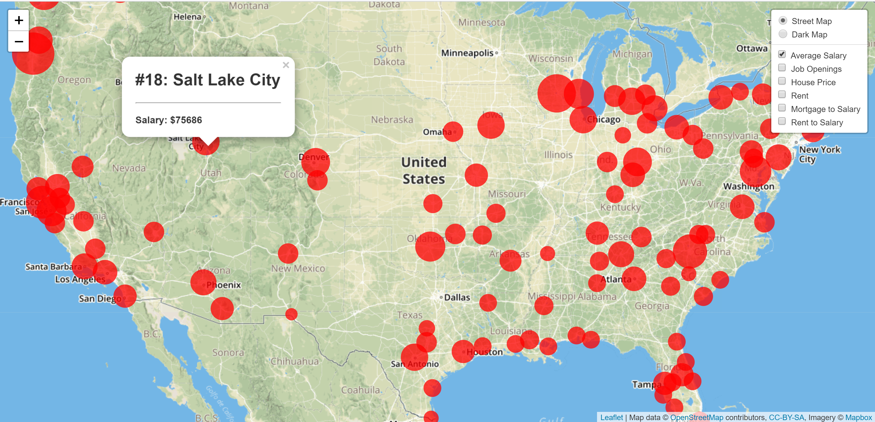
Salary

Slide 10
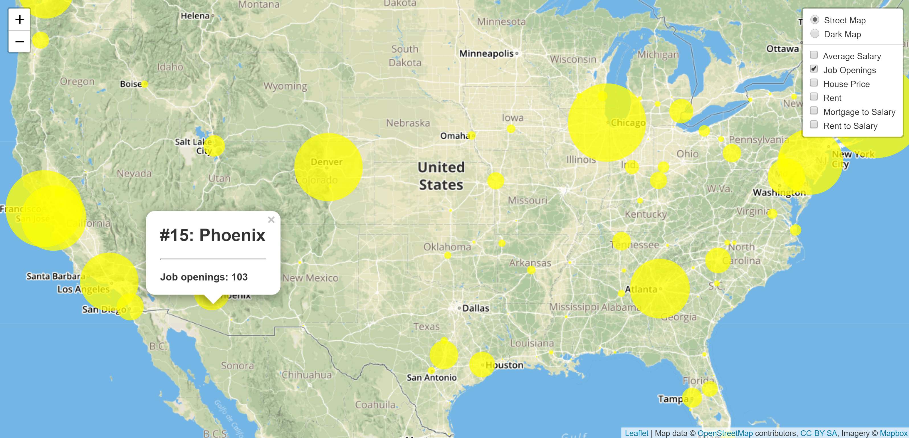
Job Openings

Slide 11
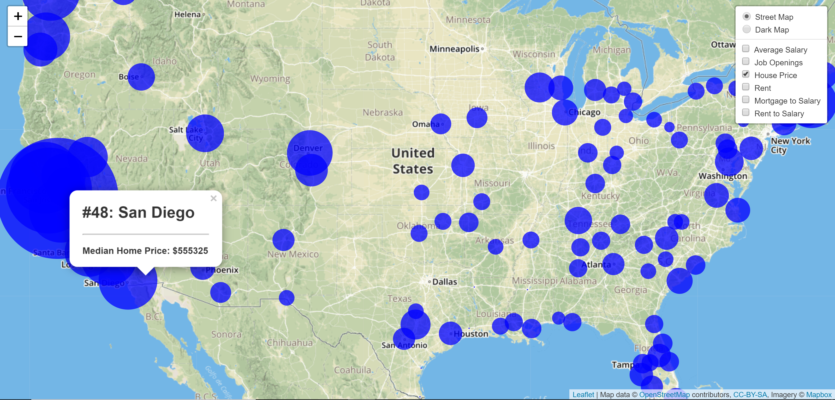
Median House price

Slide 12
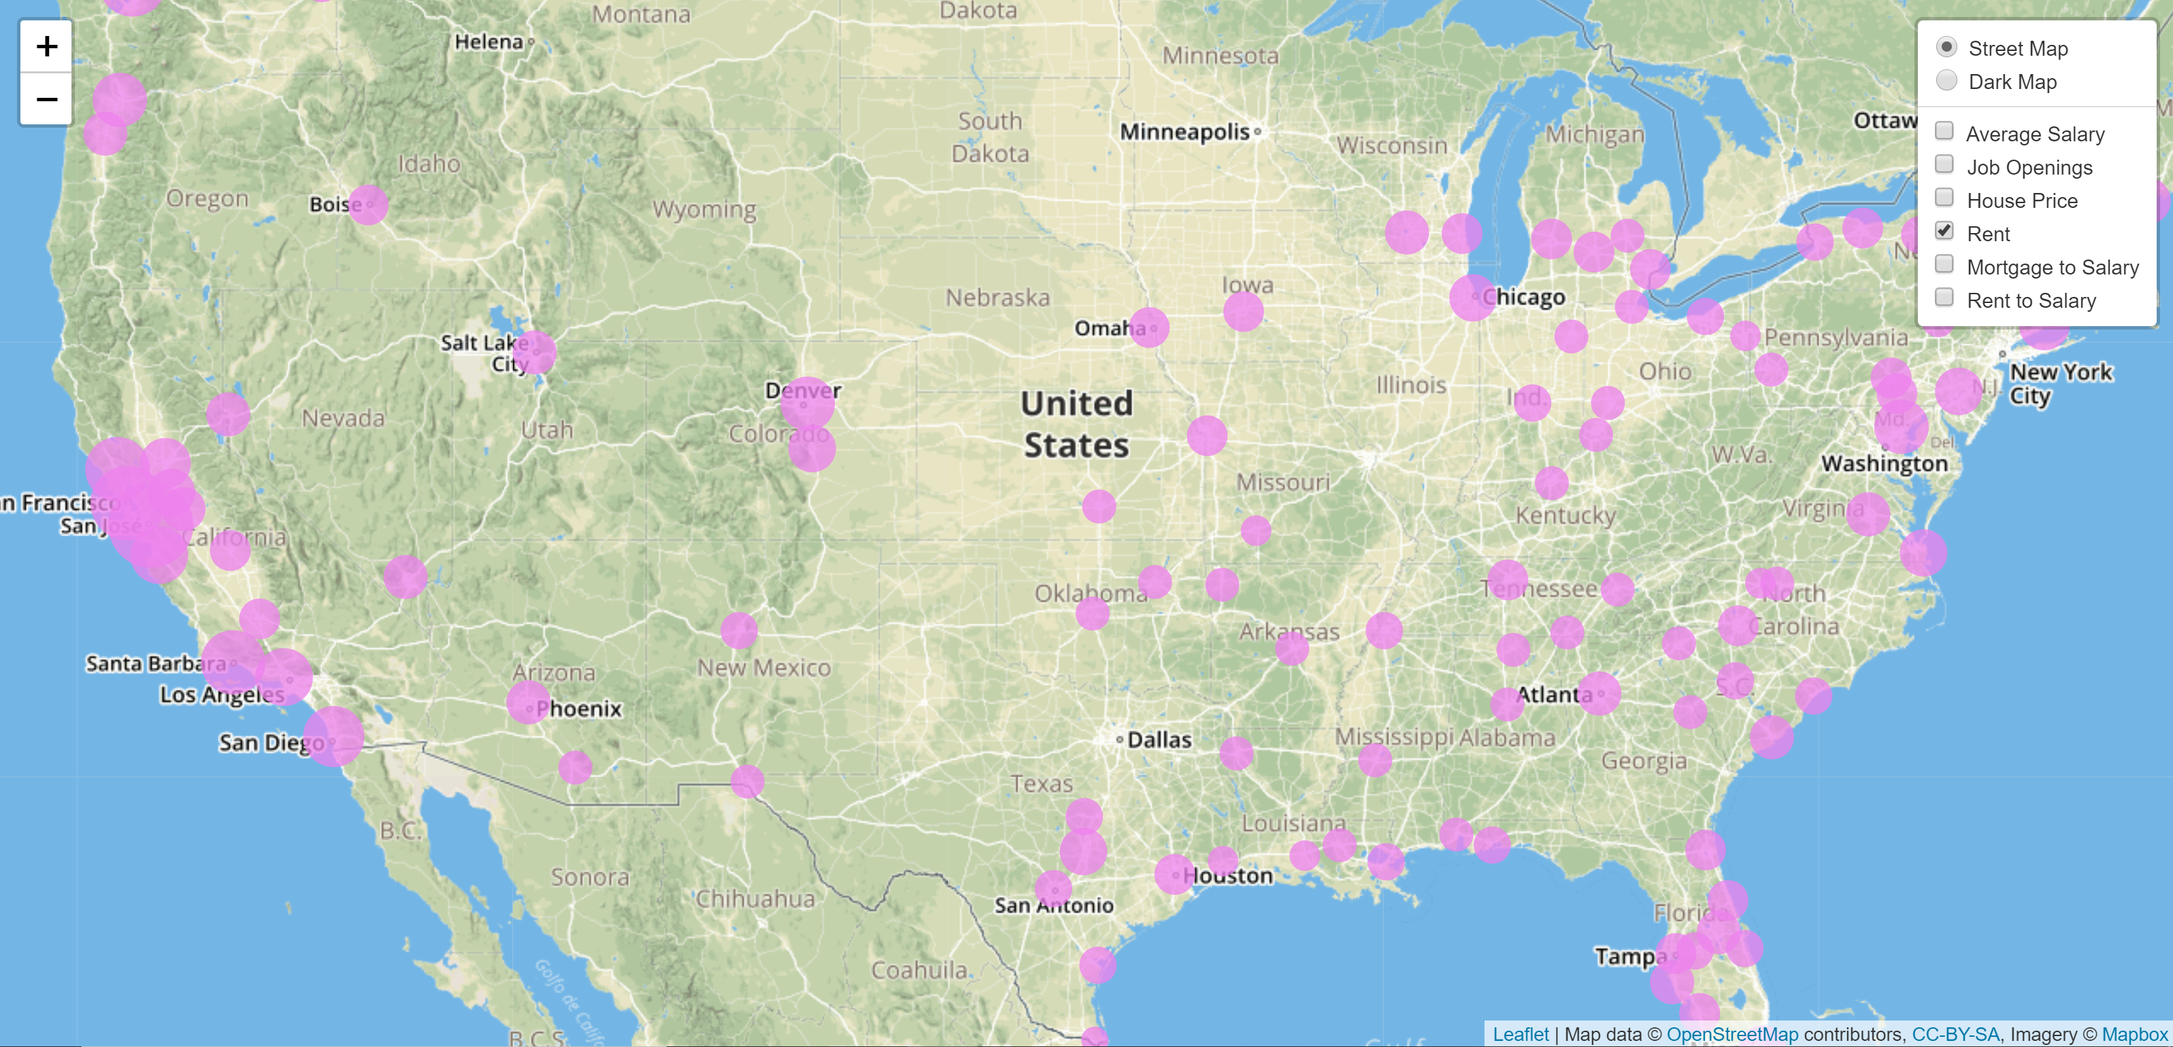
Median rent

Slide 13
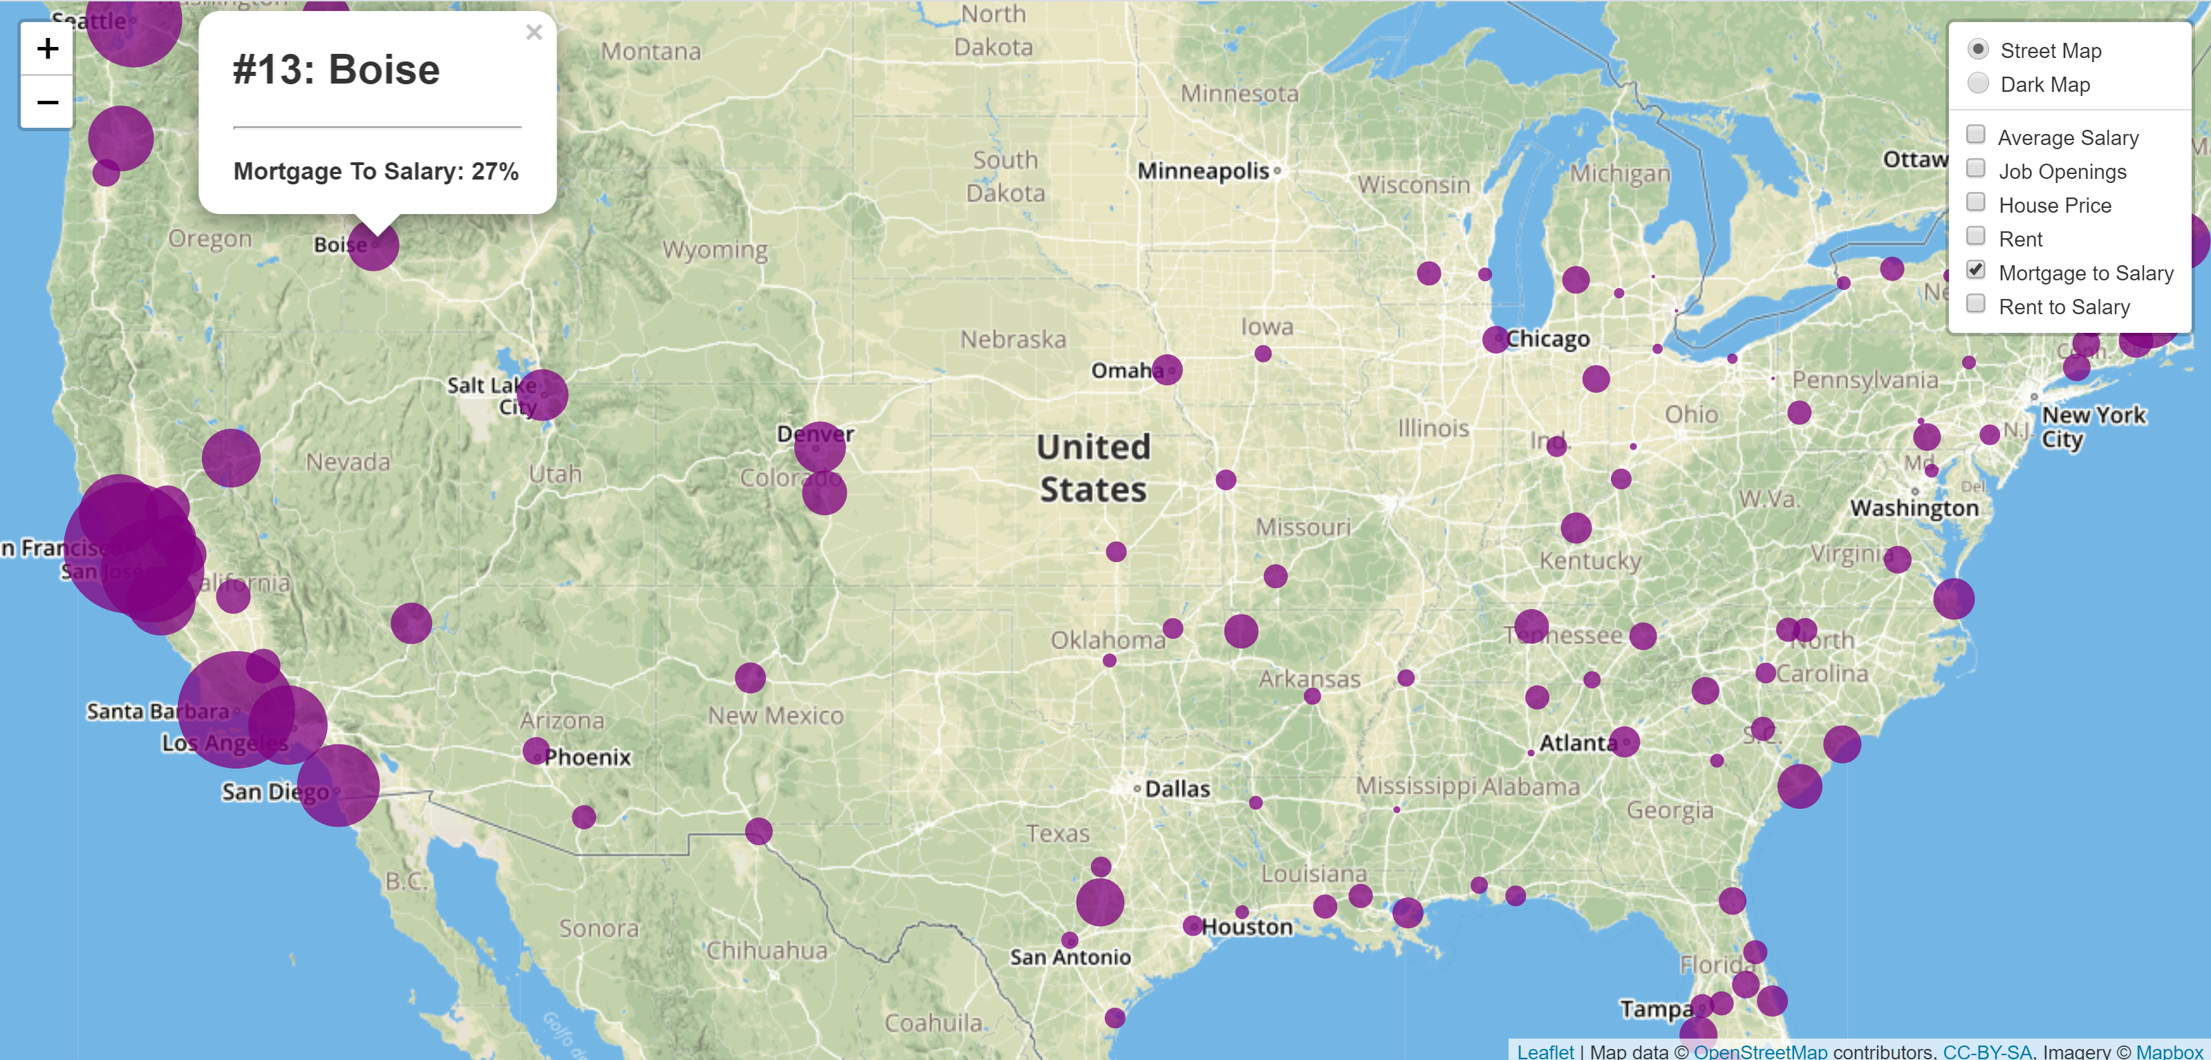
Annual Mortgage to salary ratio

Slide 14
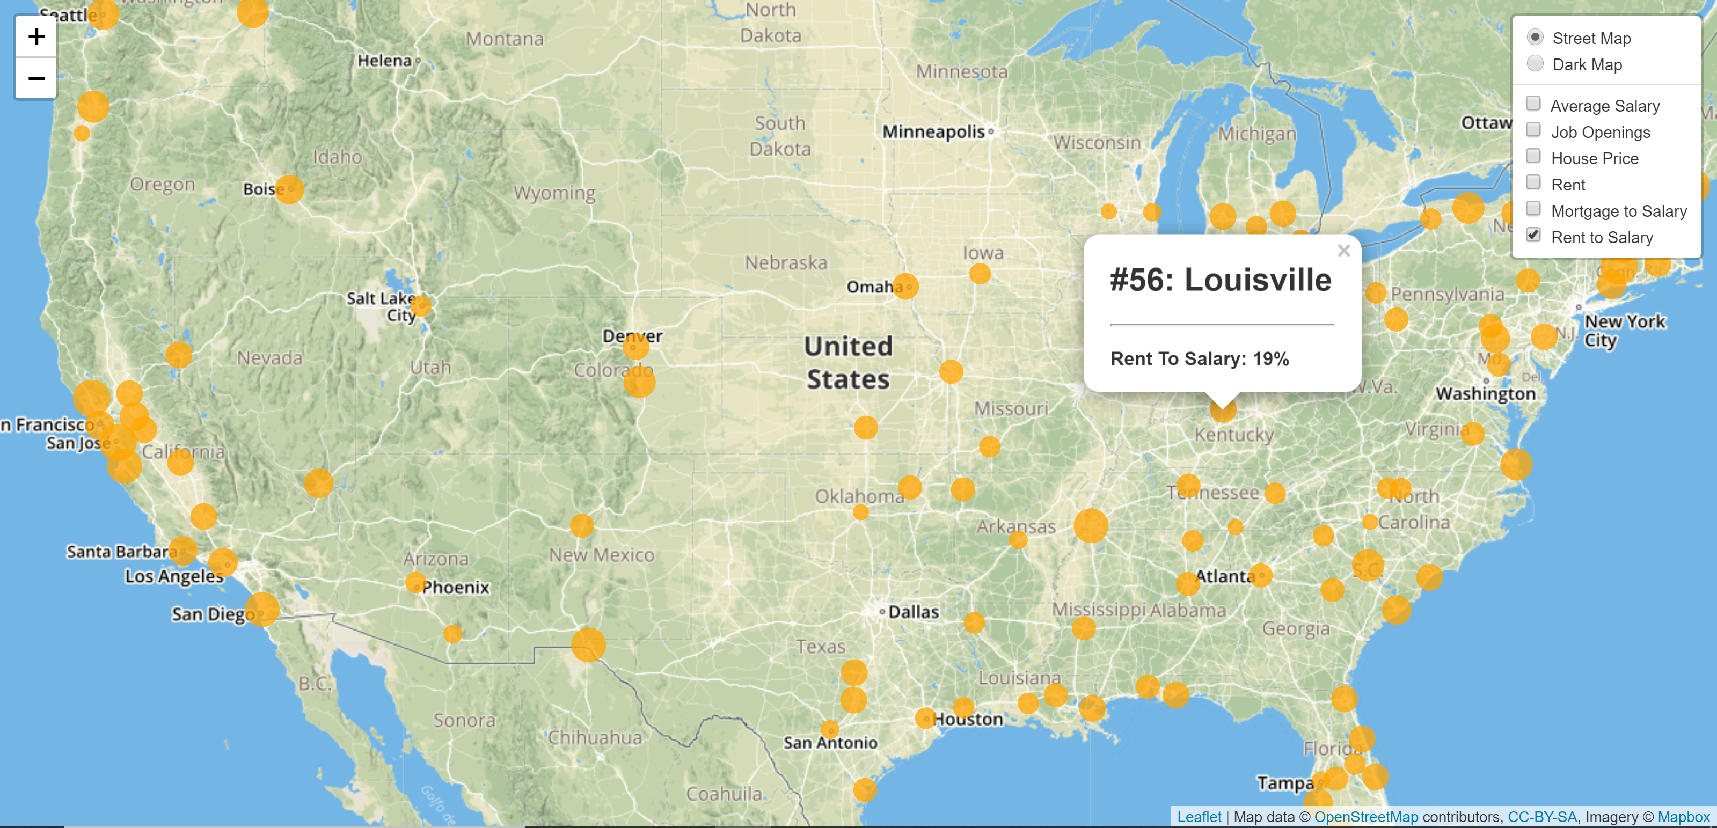
Annual Rent to salary ratio

Slide 15
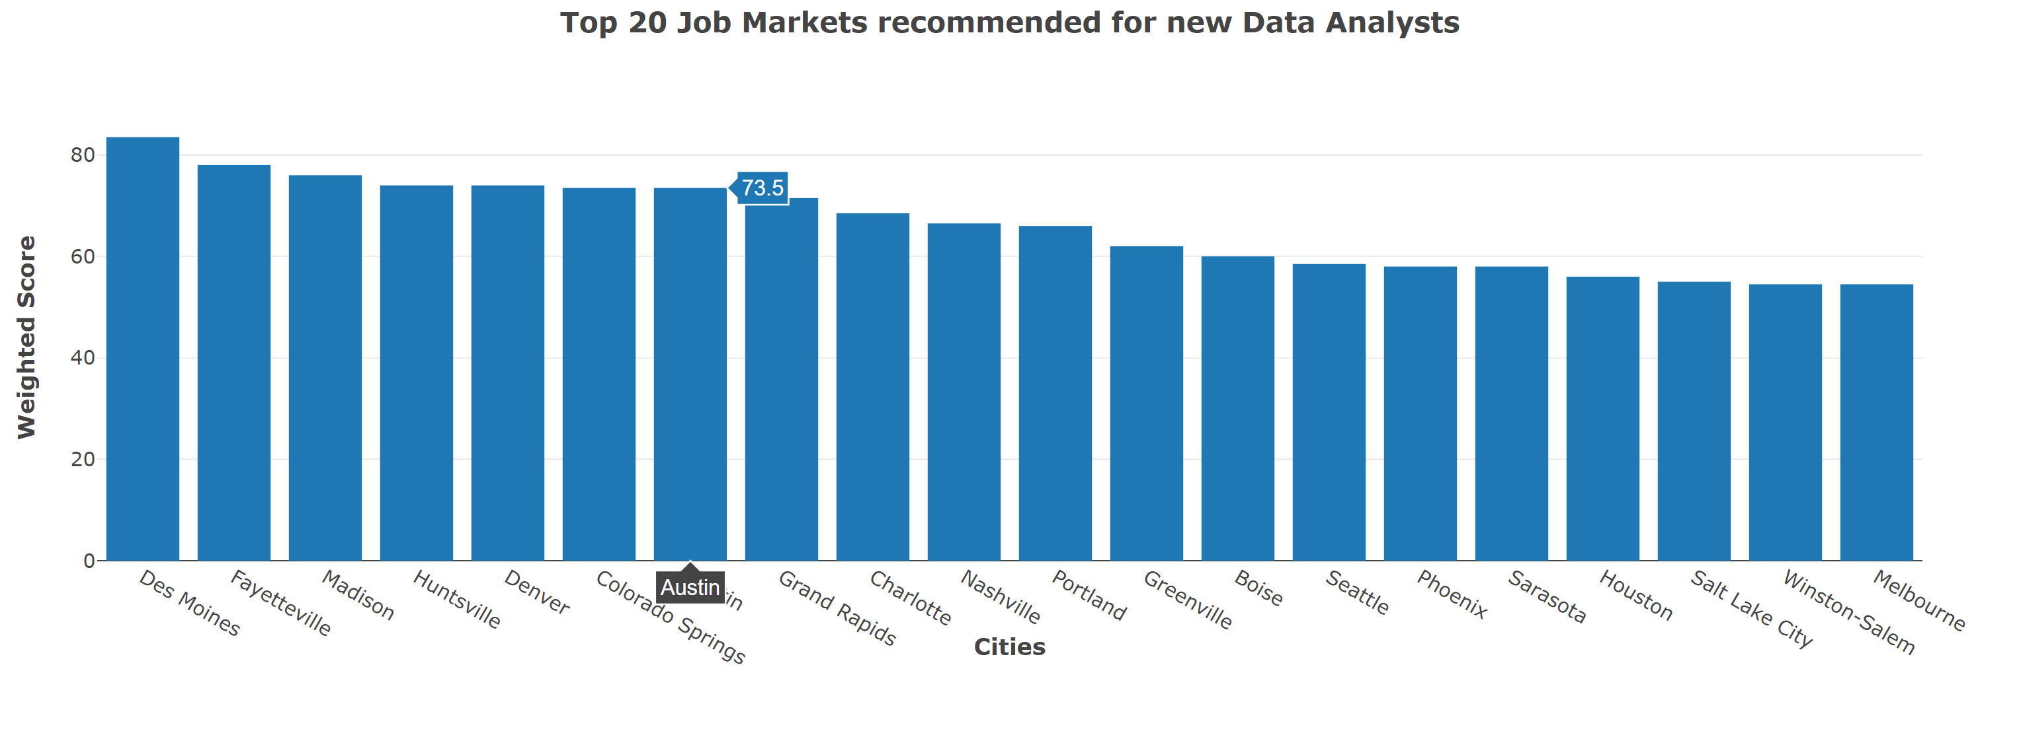
Top 20 scorer

Slide 16
And the winners are!
City | State | Positions
Des Moines | IA | 22
Fayetteville | AR | 19
Madison | WI | 14
Huntsville | AL | 11
Denver | CO | 181
Colorado Springs | CO | 7
Austin | TX | 86
Grand Rapids | MI | 11
Charlotte | NC | 73
Nashville | TN | 51
# of positions
(right)

Slide 17
Thoughts & insights
Richmond placed 45th
1 of the top 10 was East coast. 0 were west coast.
California is likely not worth it.
DC, North Carolina, Maryland
Youngstown OH, Detroit MI, Flint MI

